Slide 1
DEPARTMENT OF STATISTICS Shivaji University, KolHAPUR.
A Seminar ON PRESeNTATION
“Image Denoising Using Inter-quartile Range Filter with
Local Averaging ”
Under the guidance of
Mr. S.K.Ganjave
Name:
Godase Sangramsinh Dattatray

Slide 2
INDEX
Introduction
Types of Noise
Image Denoising
Median Filter
Interquartile Range (IQR)
Proposed IQR Filter
Permission Procedure
Estimating Noisy Pixels
Noisy Neighbours Problem
IQR Filter Algorithm
Conclusion
Reference

Slide 3
Introduction
Image quality improvement has been a concern throughout the field of image processing. Images are affected by various type of noise. One of the most important areas of image restoration is that cleaning an image occurring by noise. The goal of reducing noise is to eliminate noisy pixels. Noise filtering can be used as replacing every noisy pixel in the image with a new value depending on the neighbouring region.
The proposed algorithm in this paper focuses on how to effectively detect the noise and efficiently restore the image.

Slide 4
Types of Noise
Noise
Amplifier
Salt-and-pepper
Poisson
Speckle

Slide 5
Image Denoising
Finding unusual values in digital image.
Identifying these noisy values is an essential part of image enhancement.
In the past three decades, a variety of deposing methods have been proposed in the image processing.
Tried to remove the noisy pixels without affecting the edges, as much as possible.
One of the most common filters is the median filter.

Slide 6
Median Filter
The Median filter is a nonlinear digital filtering technique.
Median filtering is very widely used in digital image processing because under certain conditions, it preserves edges whilst removing noise.
Median filters are widely used as smoothers for image processing

Slide 7
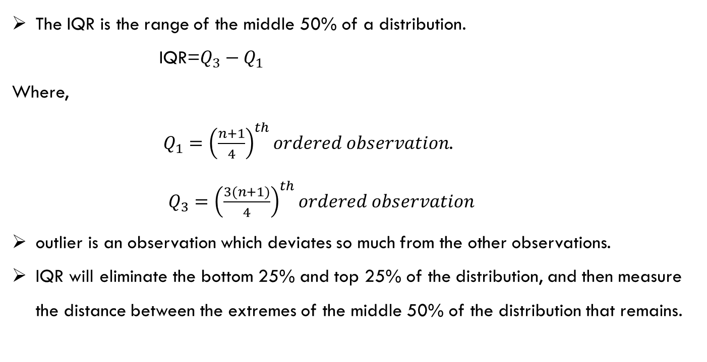
Inter-quartile Range (IQR)
The IQR is the range of the middle 50% of a distribution.
IQR=$Q_{3}−Q_{1}$
Where,
$Q_{1}={\left(\frac{n+1}{4}\right)}^{th}ordered observation$.
$Q_{3}={\left(\frac{3(n+1)}{4}\right)}^{th}ordered observation$
outlier is an observation which deviates so much from the other observations.
IQR will eliminate the bottom 25% and top 25% of the distribution, and then measure the distance between the extremes of the middle 50% of the distribution that remains.

Slide 8
Proposed IQR Filter
In order to apply IQR filter, a window of size k×k was used to implement the proposed method.
The pixels in the k×k window are sorted in ascending order in order to calculate IQR
All the pixels that lie outside the IQR are treated as suspected pixels (SP).
Permission Procedure
Not all the pixels outside the IQR are noisy.
A threshold may be established to permit the external pixels (the pixels outside the IQR) to be in or out.

Slide 9

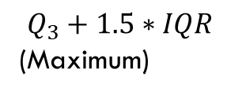

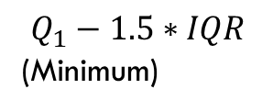


Noisy-Suspected Pixels
Suspected Pixels
$T_{1}$
$$Q_{1}$$
$$Q_{3}$$
$T_{2}$
$Q_{1}−1.5∗IQR$
(Minimum)
$Q_{3}+1.5∗IQR$
(Maximum)
IQR

Slide 10
Estimating Noisy Pixels
After the determination of the noisy pixels, the estimation method used to donate a value for each noisy image is the local averaging.
First, the noisy Pixels could be classified into three types.
Interior Noise
Border Noise
Corner Noise

Slide 11
Noisy Neighbours Problem
Noise pixels may be neighbors in the image array.
The procedure of local averaging could be risky.
IQR Filter Algorithm
For each window of size k×k do the following:
Start
Compute Q1, Q3, and IQR distance
Find all suspected noisy pixels outside IQR distance
Compute the permission distance by two thresholds T1 and T2
Return all pixels within T1 and T2 to the non-noisy pixels
Estimate all noisy pixels greater than T1 and T2 by local averaging
Stop

Slide 12
Conclusion
New and simple approach for removing salt and pepper noise from corrupted images has been presented.
It can be seen that IQR filter preserves edge sharpness better of the original image than median filter
As a main conclusion from this article is that whenever the window size is increased the preserving of the edges is not affected highly which is on the contrary of the median filter

Slide 13
Reference
International Journal of Science and Research (IJSR) ISSN (Online): 2319-7064
Author:Senthilkumar Palaniappan PG student, Department of ECE, Velalar College of Engineering and Technology Anna University, Chennai, India

Slide 14
Thank You….

